Slide 1

Agent-based modeling of an epidemic
Centre for
Educational Development
Notes:
See speak + storyboard for video at:
https://docs.google.com/document/d/1-Y_PeO3UXHfrTS_SYd5FA4mTE2rKcft5_H8yP__Rh2w/edit#
Tjek logoplacering?

Slide 2
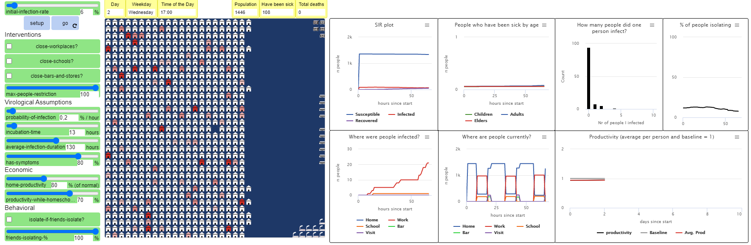
The University curricular unit
Theory of Science, BA and MA (2-hour lecture & workshop)
What are models, and how do they embody ‘theory’?
What are the limitations of models, and how does that affect what we can know with a model?

Slide 3




A TYPICAL day in an ADULT agent’s life
WEDNESDAY:
8:00 – Go to workplace
17:00 – Go to a bar with friends (if in a social mood)
20:00 – Go home
SATURDAY:
13:00 – Go to a friend’s house to hang out
17:00 – Go home
Notes:
(pedagogical explanation of how the model runs, agent behaviour, different buildings, etc)

Slide 4
What big question does the model answer?
What are the best strategies for balancing human life with the economic impact of a lockdown?
The simulation is a virtual lab which allows us to experiment with the epidemic
It may not give specific answers, but it helps us better understand the complex system
Notes:
slide

Slide 5
limitations
Remember: the model is a simplification of reality
What does it NOT include?
What else could be important? What would you add to the simulation?
What about…
The psychological wellbeing of agents?
(one more example)?
How do these limitations affect what we can know with the model?

Slide 6
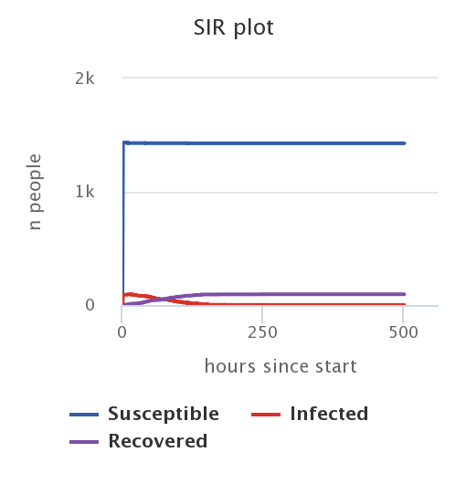
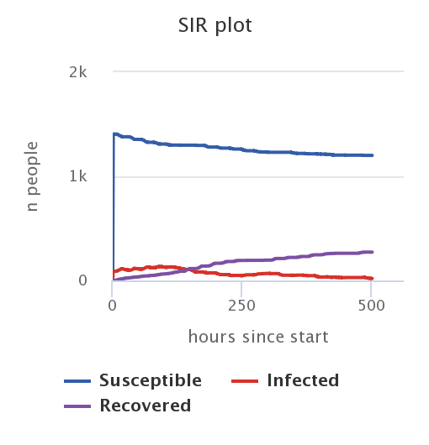
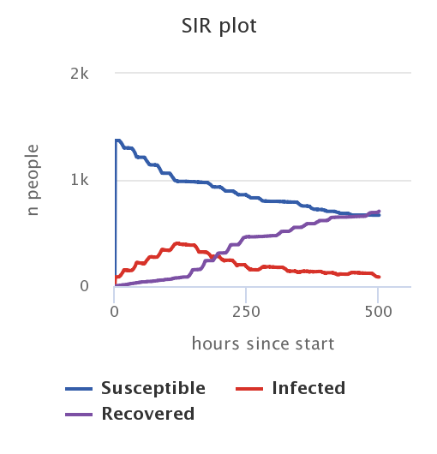
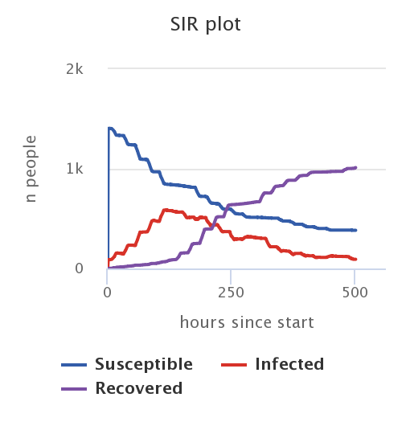
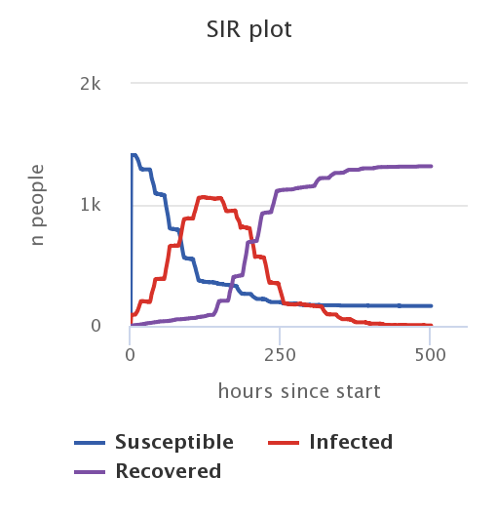
Comparing runs: % with symptoms
Varying the percentage of infected agents that develop symptoms:
100%
75%
50%
25%
0%
Notes:
(also look at other plots, show in model run: productivity plot and % of people isolating. It’s all connected!
Maybe mention: every run is different, so slight variation (these aren’t average plots, but just plots from single runs)
All other settings kept constant: initial rate 6%, no interventions, max people 100, 0.2% inf, 12 hours inc, 130 hours avg dur, isolate if friends isolate OFF

Slide 7




The causal chain: on agent-level
Agent develops symptoms
Agent self isolates and stops spreading the virus
An agent gets infected
INCUBATION TIME
Agent does not know they are sick, but can still spread the virus
Agent does NOT self isolate and may continue spreading the virus
Agent does NOT develop symptoms
Notes:
Explain causal chain

Slide 8

Try it out for yourself!
Download the model at (LINK)
Documentation at (LINK)
A lot more to explore!
(contact info?)
(guidelines til EDU-IT logo?)

Slide 9
Centre for
Educational Development

Slide 10
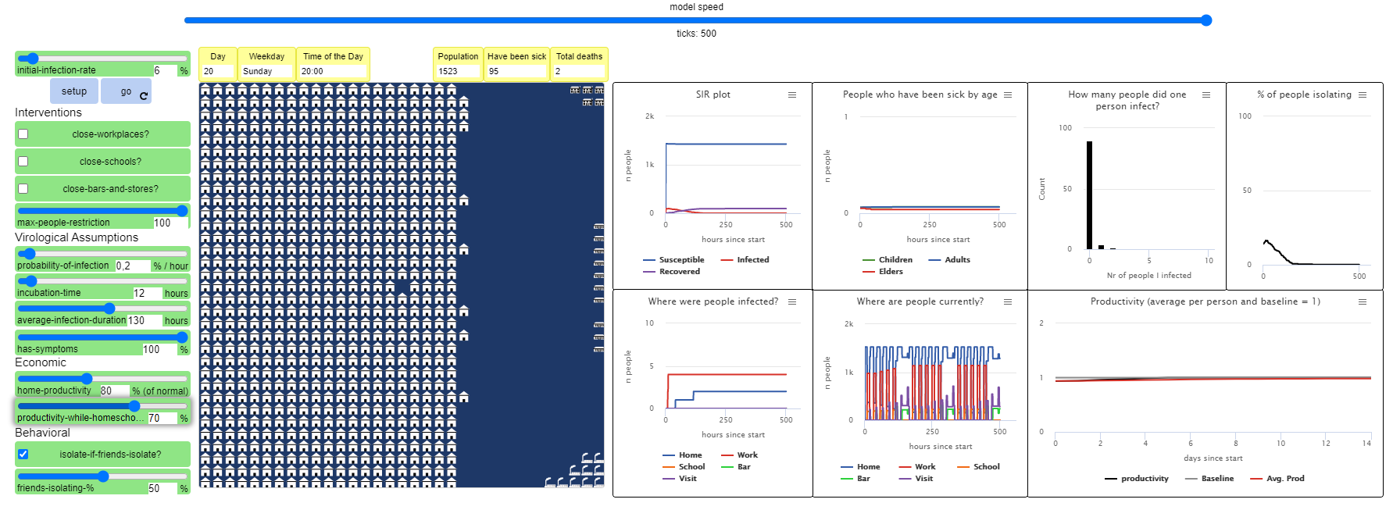
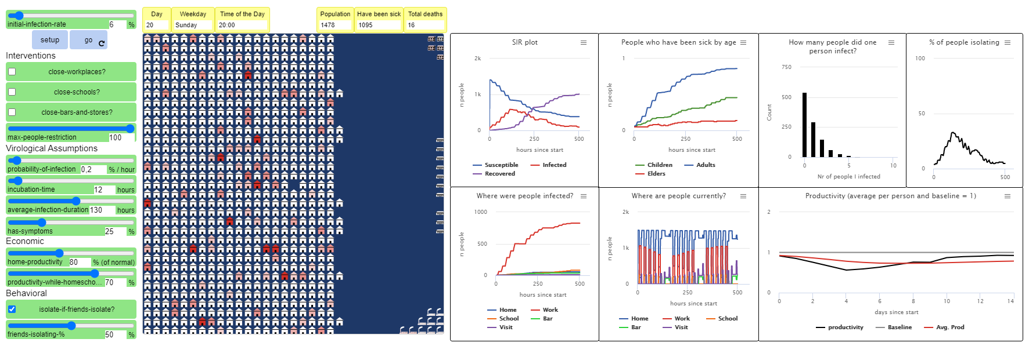
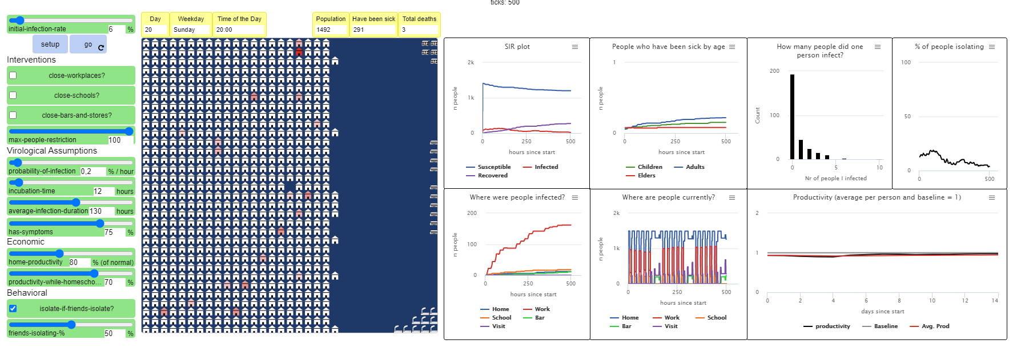
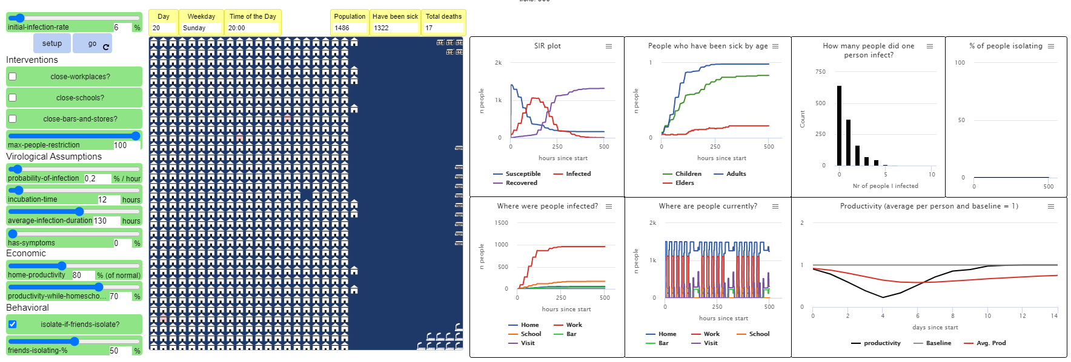
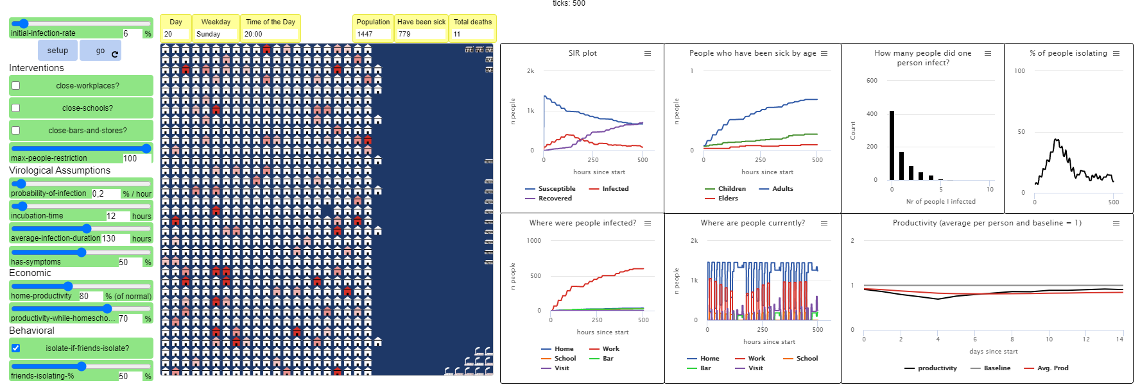
Notes:
(med 0.2% inf per hour, varying %-with-symptoms) (just for reference)

Slide 11
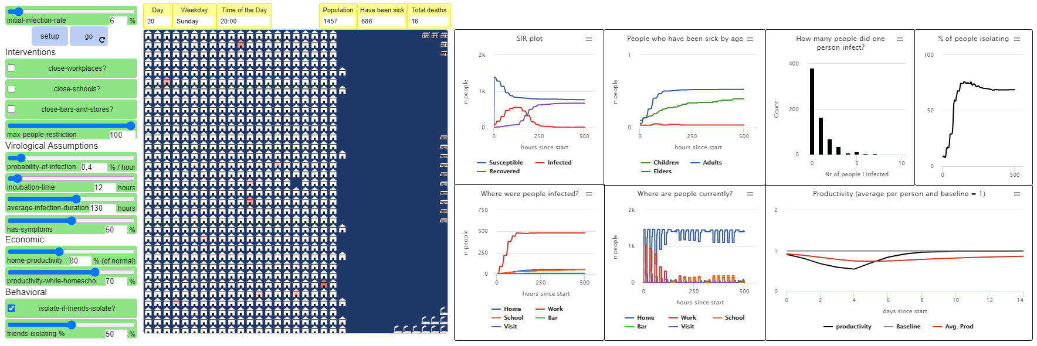
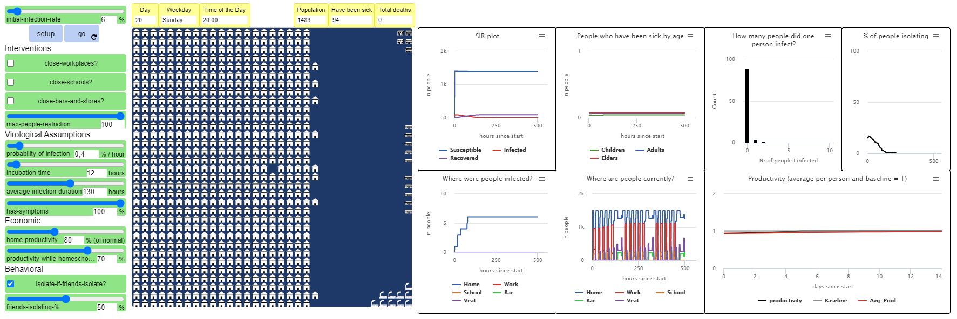
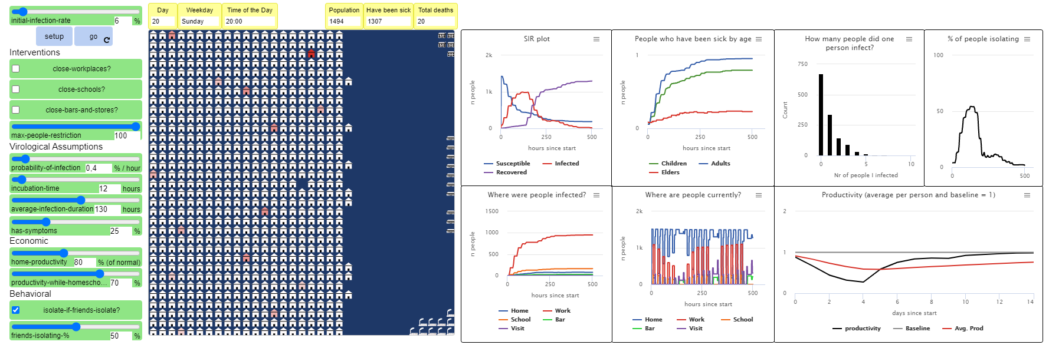
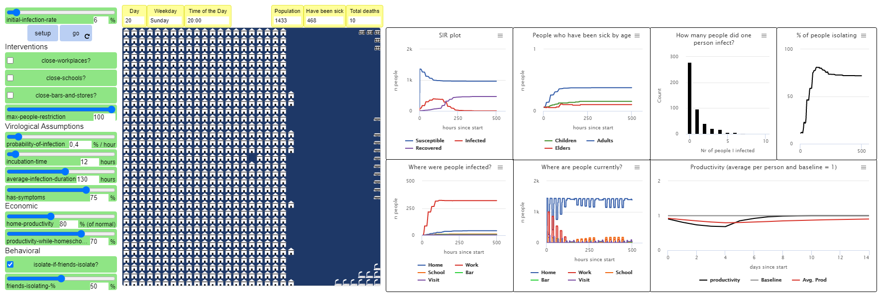
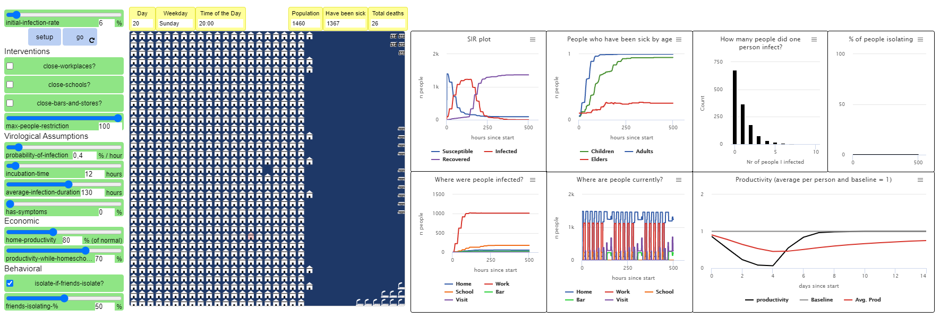
Notes:
(med 0.4% inf per hour, varying %-with-symptoms) (just for reference)

Slide 12
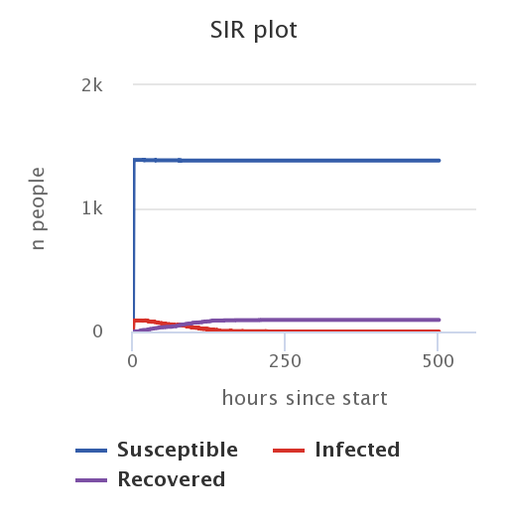
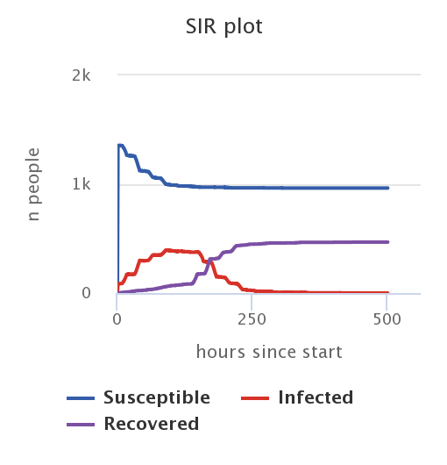
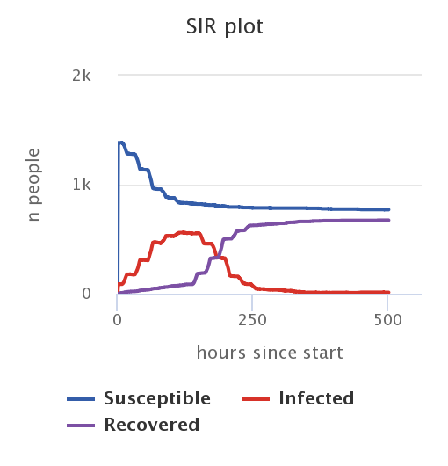
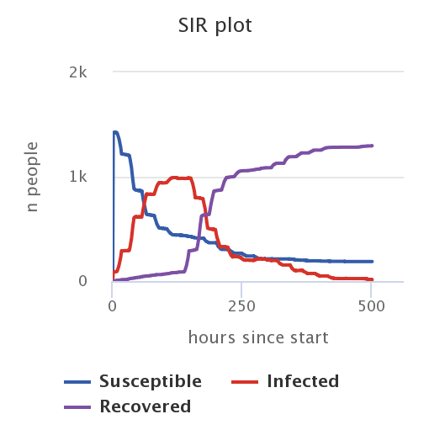
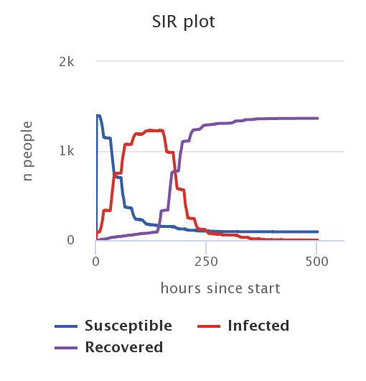
Comparing runs: % with symptoms
Varying the percentage of infected agents that develop symptoms (0.4% inf-pr-hour):
100%
75%
50%
25%
0%
Notes:
(DON’T INCLUDE THIS SLIDE)
(NU MED 0.4% inf per hour!)
All other settings kept constant: initial rate 6%, no interventions, max people 100, 0.4% inf, 12 hours inc, 130 hours avg dur, isolate if friends isolate OFF

